Slide 1
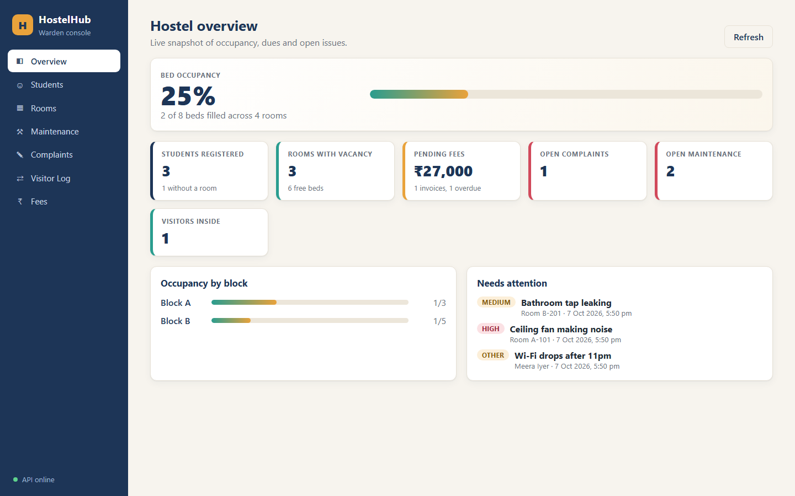
DEVOPS CAPSTONE PROJECT
HostelHub
A hostel management platform,
packaged and delivered with DevOps
FastAPI • React • PostgreSQL
Docker • GitHub Actions • Kubernetes
Project repository: github.com/tarun250/hostel_management
01

Slide 2
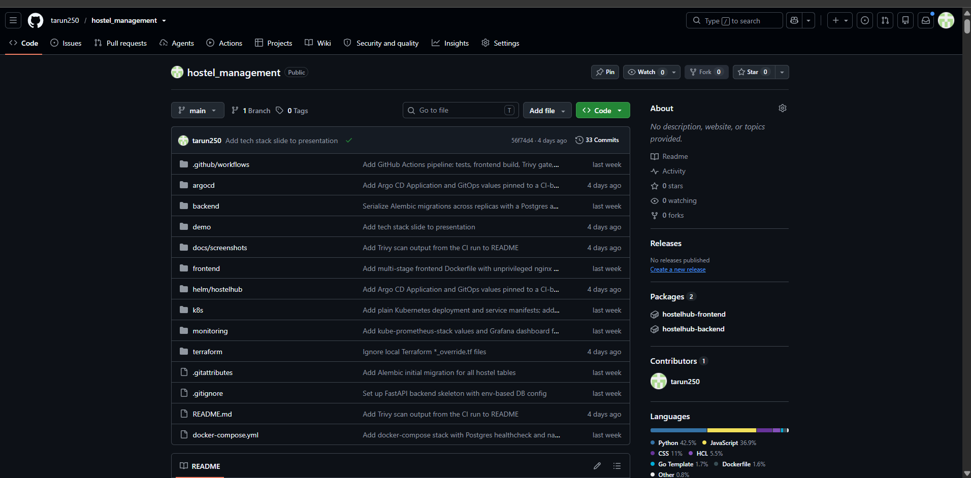
01 / SOURCE CODE
GitHub repository and project structure
Repository: github.com/tarun250/hostel_management • Frontend, backend, Compose, CI/CD, Helm, Kubernetes, monitoring and Terraform files.

Slide 3
01 / PRODUCT OVERVIEW
The problem and the solution
The problem
The solution
• Records scattered across registers
• Free beds are hard to track
• Complaints, visitors and fees slip through
• One dashboard for the warden
• Room allocation that respects capacity
• Maintenance, complaints, visitors and fees in one place
02

Slide 4
02 / PRODUCT FEATURES
What the application does
01
02
03
Dashboard
Students & rooms
Maintenance
Occupancy, free beds, dues and open issues.
Register students; allocate and vacate beds.
Move requests through open, in progress and resolved.
04
05
06
Complaints
Visitors
Fees
Track issues from open to review and closure.
Log check-in and check-out.
Track pending and paid fees, including overdue status.
03

Slide 5
03 / HOW THE PIECES FIT
System architecture
Browser / React UI
FastAPI backend
PostgreSQL
Local development: Docker Compose runs the frontend, backend and database together.
Delivery & operations
• GitHub Actions tests, builds, scans and publishes container images.
• Helm deploys to Kubernetes; Argo CD supports GitOps sync.
• Prometheus scrapes metrics and Grafana visualizes them.
• Terraform defines AWS VPC and EKS infrastructure.
The repository contains the code, Dockerfiles, workflow, Helm chart, monitoring config and Terraform files.
04

Slide 6
04 / STACK RATIONALE
Technology choices — and why
React + Vite
Responsive interface with fast local development.
FastAPI + SQLAlchemy
Python API, validation, generated API docs and database access.
PostgreSQL
Relational data suits students, rooms, fees and their relationships.
Docker Compose
Simple, reproducible local multi-container environment.
Kubernetes + Helm
Declarative rollout, service discovery, replicas and configuration.
GitHub Actions + Trivy
Automated checks and vulnerability scanning in the delivery path.
Prometheus + Grafana
Collect application metrics and make operational signals visible.
05

Slide 7
04 / STACK RATIONALE
Alternatives considered
FastAPI
over Flask / Django: typed validation and Swagger docs built in
React + Vite
over Angular / plain HTML: lighter, fast dev server
PostgreSQL
over MySQL / MongoDB: relational data with strict constraints
GitHub Actions
over Jenkins: lives next to the code, no CI server to run
Kubernetes + Helm
over Docker Swarm: industry standard, one chart for every env
Argo CD
over Flux / push deploys: UI shows sync state and drift
Terraform
over CloudFormation: cloud-agnostic, reusable VPC/EKS modules
06

Slide 8
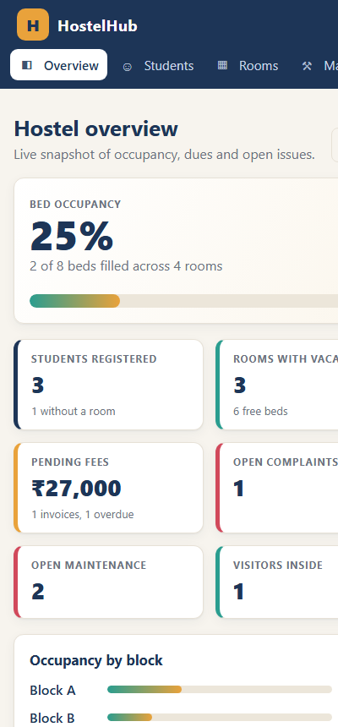
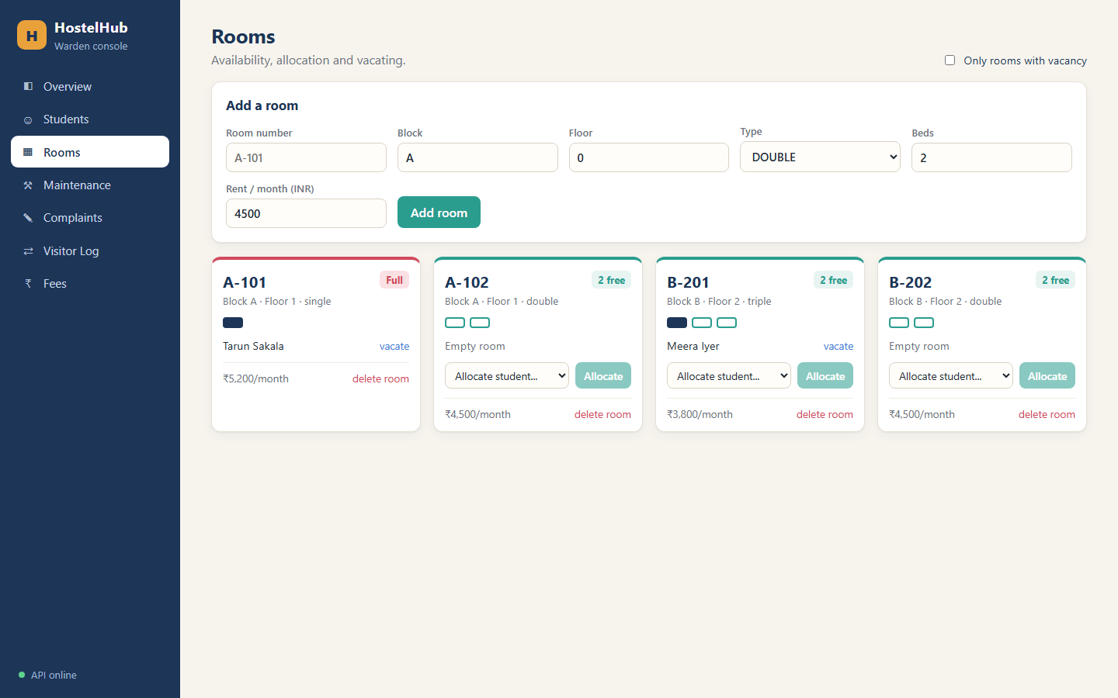
05 / USER INTERFACE
The product in action
Dashboard • mobile layout • room availability
07

Slide 9
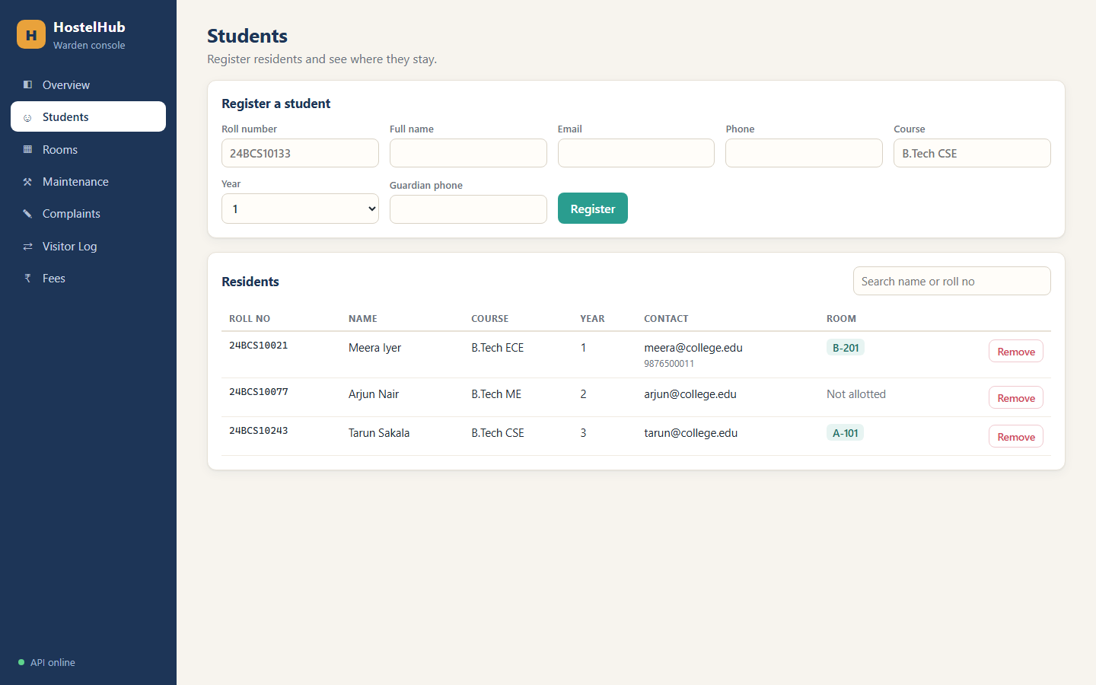
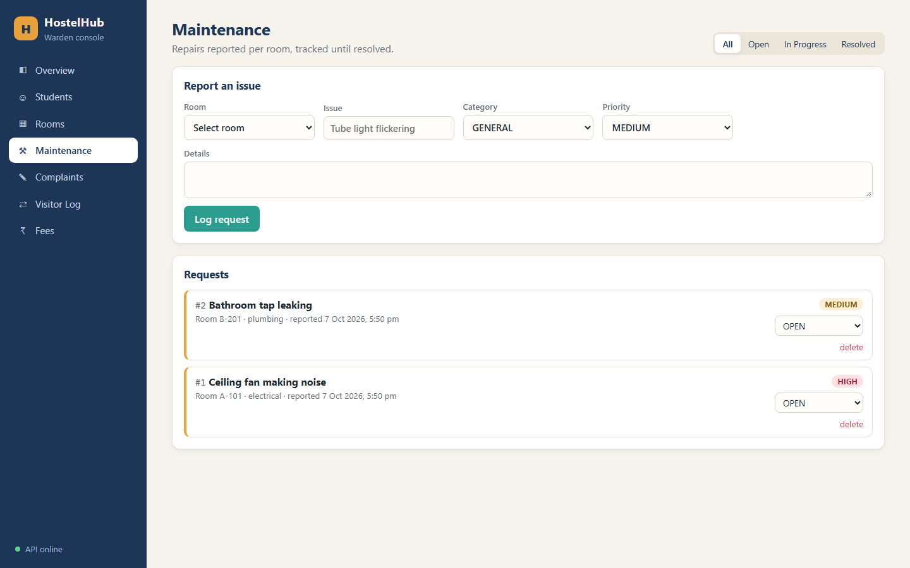
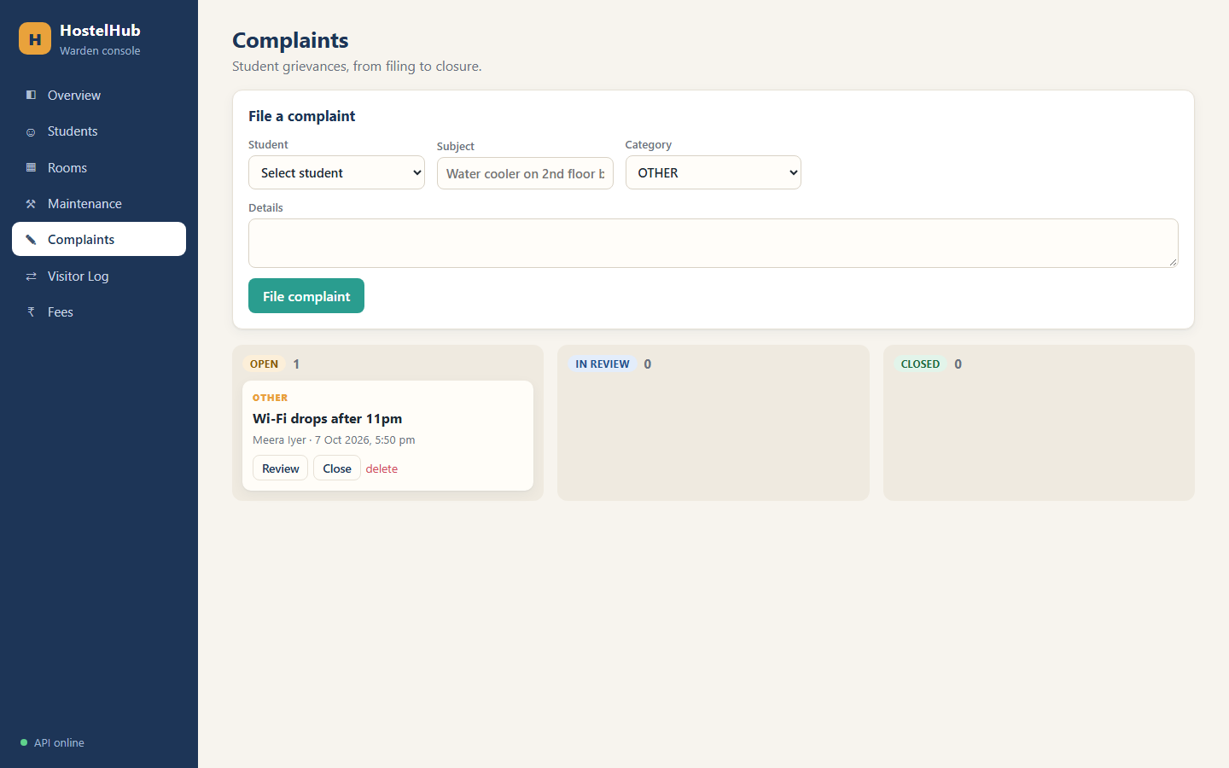
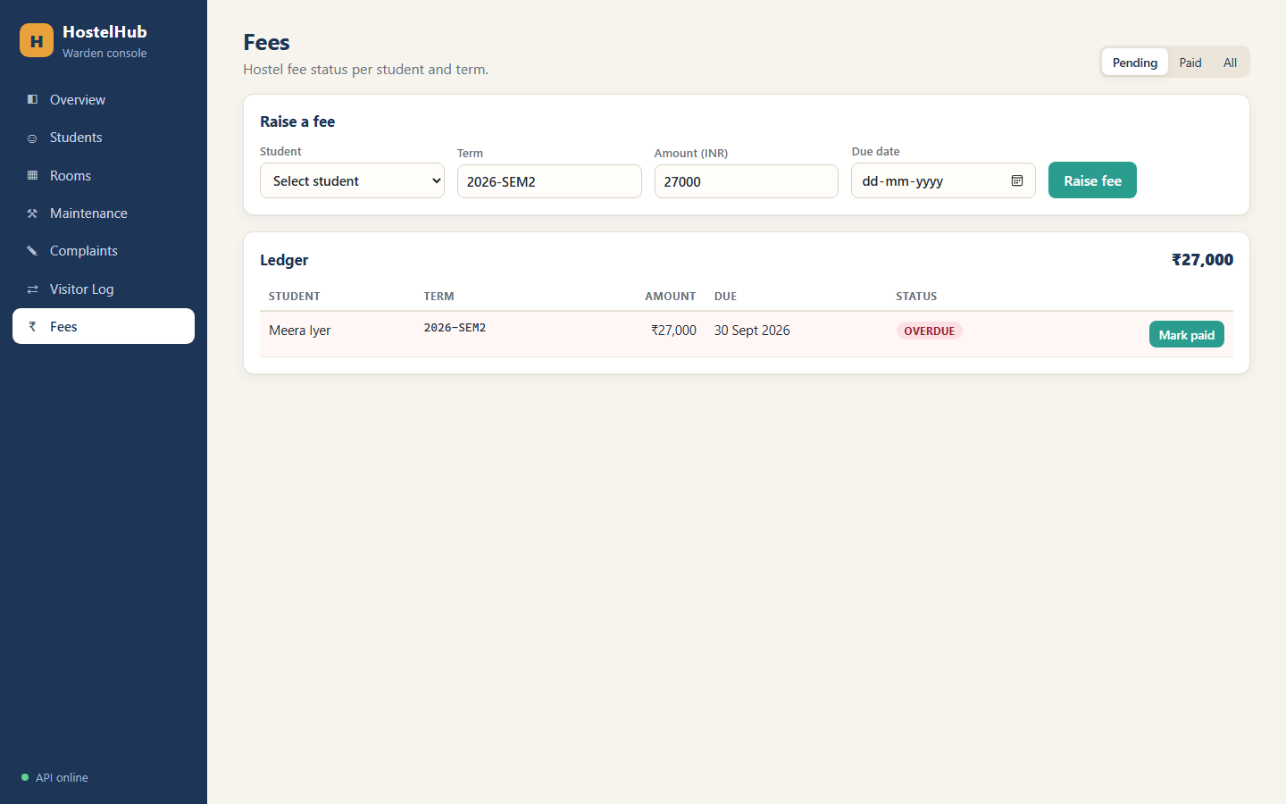
06 / REAL APPLICATION SCREENS
Core workflows
Student records • maintenance requests • complaints • fee tracking
08

Slide 10
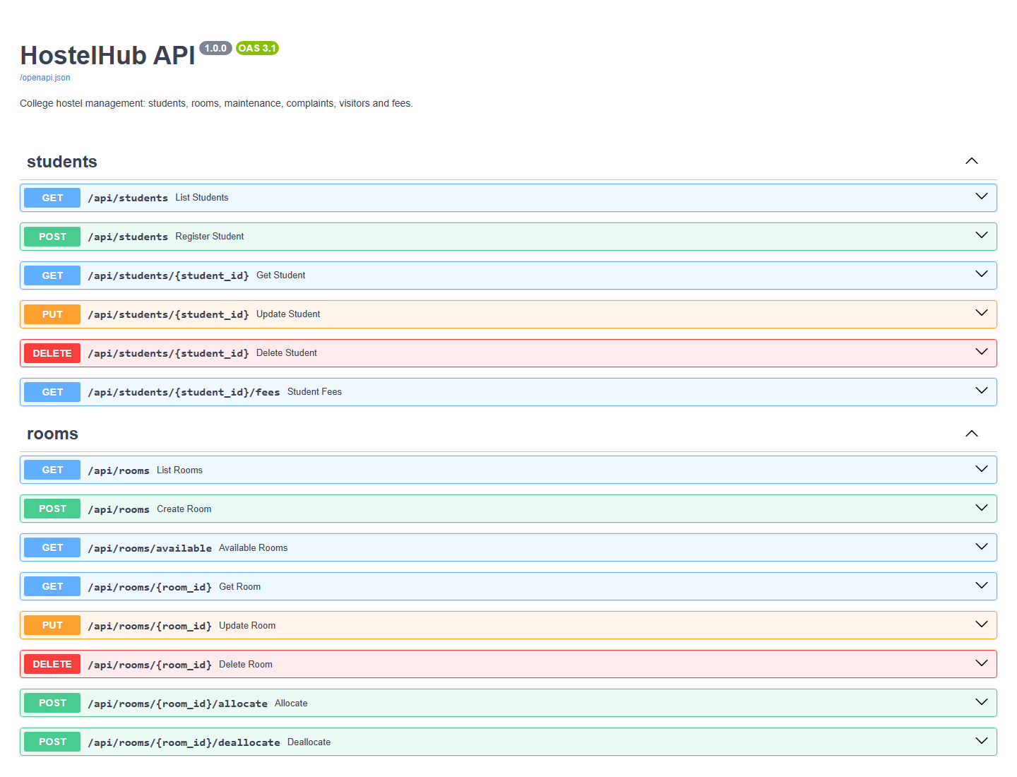
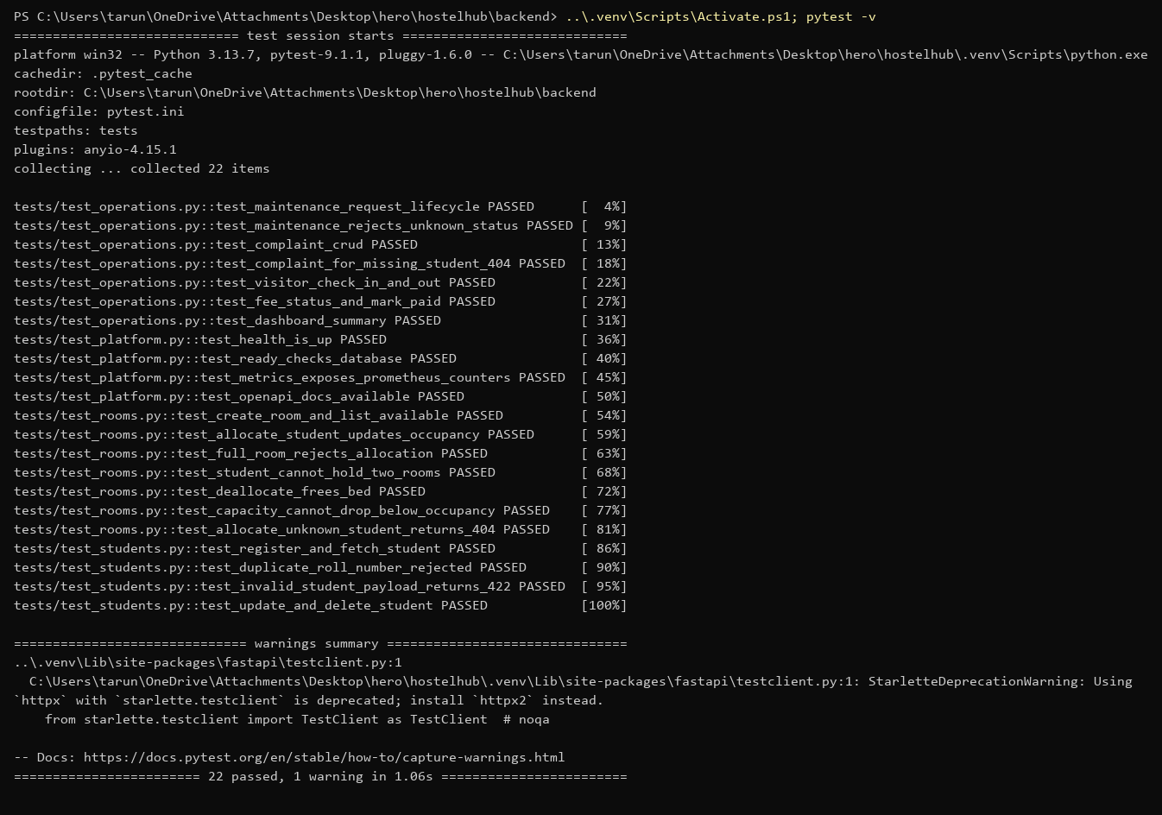
07 / CORRECTNESS
Backend API and automated tests
API checks
Health and readiness endpoints; interactive Swagger documentation.
Test suite
README reports 22 pytest tests using in-memory SQLite, not the real database.
09

Slide 11
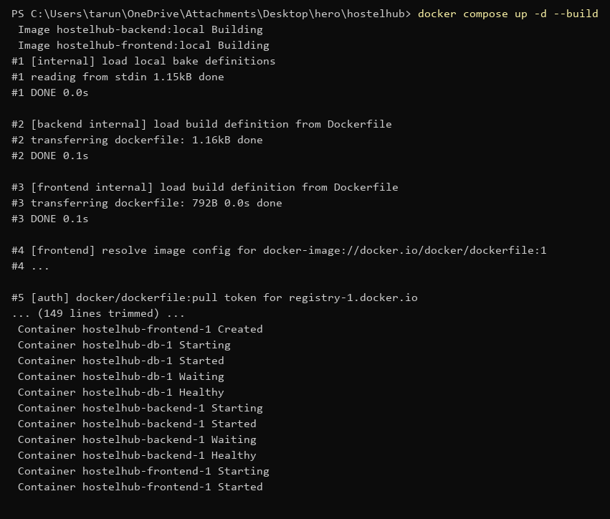
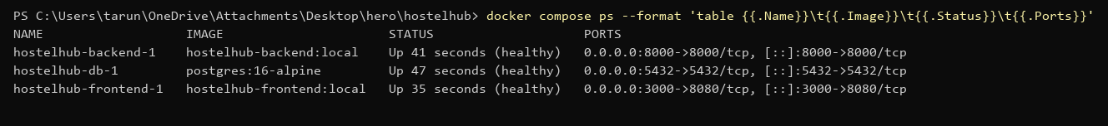
08 / REPEATABLE DEVELOPMENT
Local environment with Docker Compose
One command builds and starts the frontend, API and PostgreSQL; compose ps confirms container status.
10

Slide 12
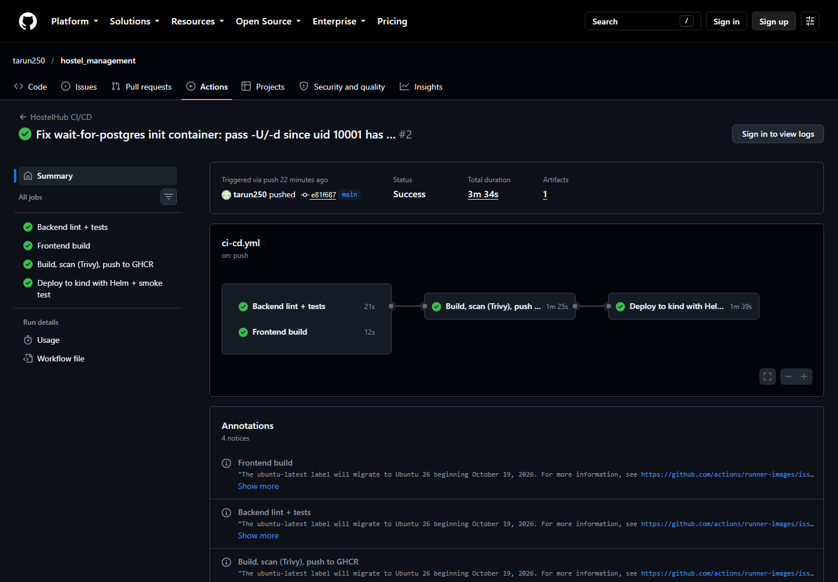
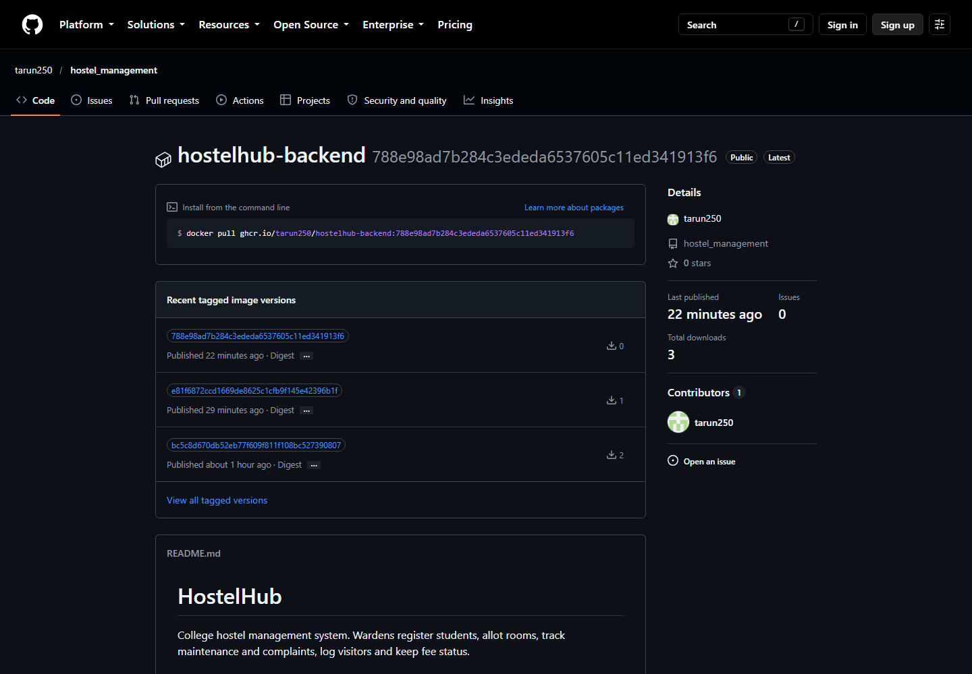
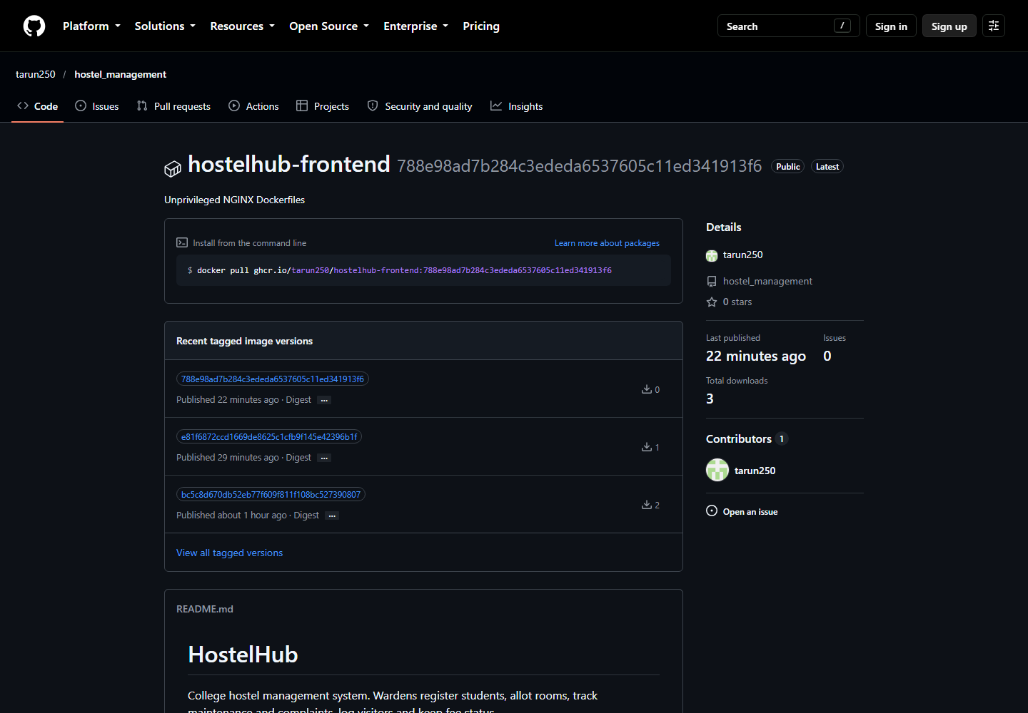
09 / FROM COMMIT TO DEPLOYMENT
CI/CD pipeline
1
2
3
4
5
Test
Build
Scan
Publish
Deploy
ruff + pytest
Frontend + images
Trivy security gate
GHCR on main
kind + Helm + smoke tests
Repository README links the latest green GitHub Actions run; images are published to GitHub Container Registry.
11

Slide 13
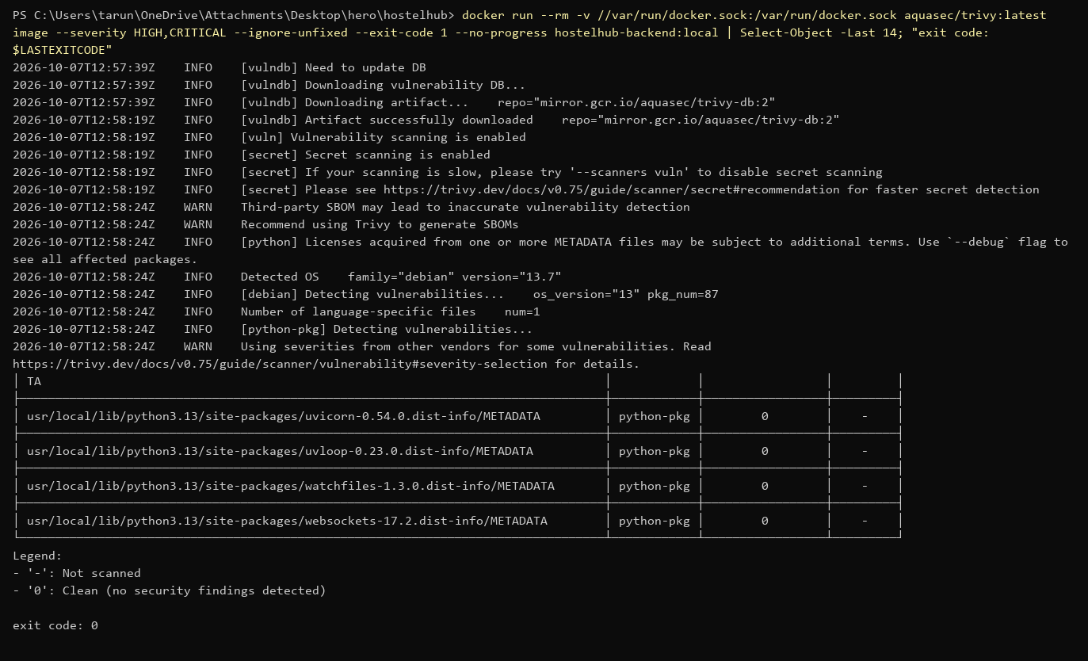
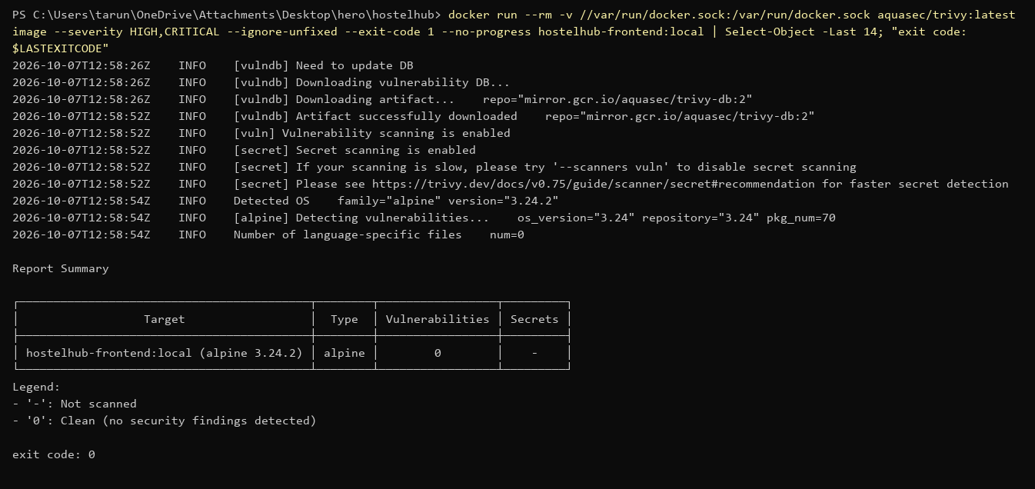
10 / IMAGE SCANNING
Security checks in the pipeline
README reports 0 fixable HIGH/CRITICAL CVEs in the final backend and frontend scans. The CI gate uses Trivy with --ignore-unfixed.
Images run as non-root users; backend runtime removes pip to reduce unnecessary packages.
12

Slide 14
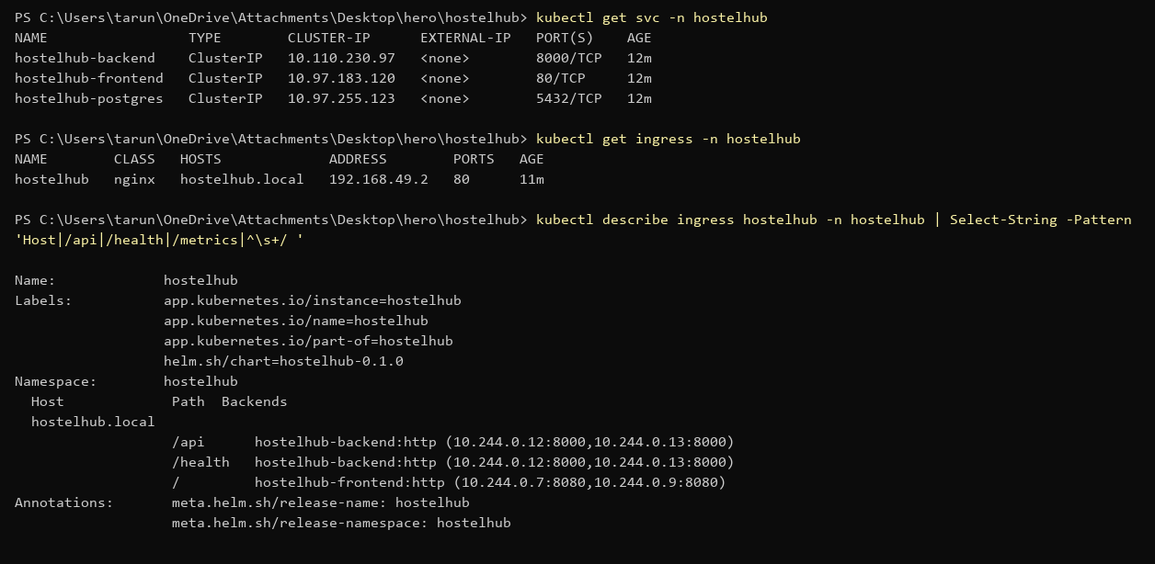
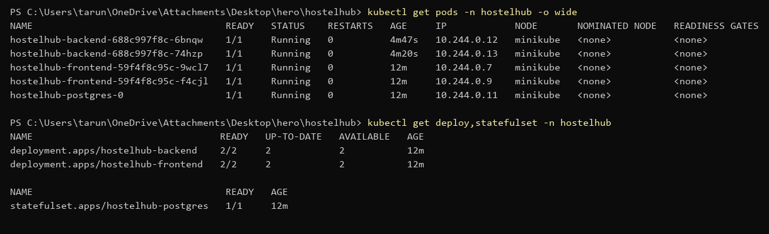
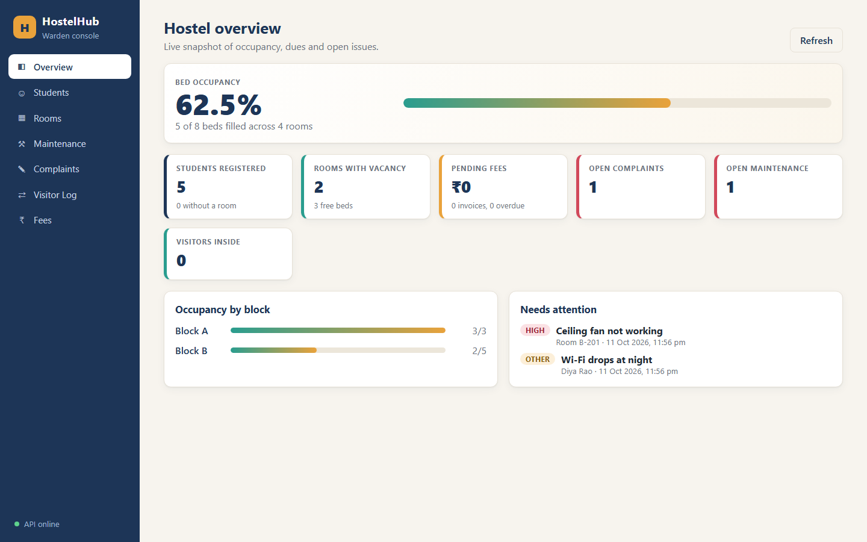
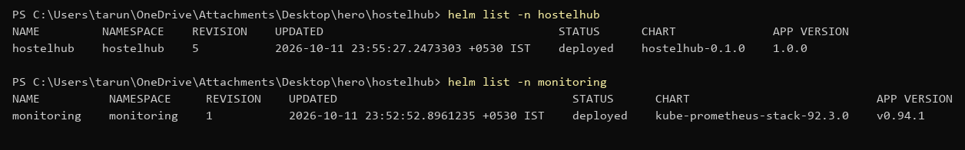
11 / ORCHESTRATION
Kubernetes deployment
Helm chart manages the application resources; Ingress routes browser traffic to the frontend and /api to FastAPI.
13

Slide 15
12 / DESIGN DECISION
Why Kubernetes instead of only Docker Compose?
Docker Compose
Kubernetes + Helm
• Great for local development
• One command starts all three containers
• No self-healing or scaling across nodes
• Replicas, self-healing, rolling updates
• Services + Ingress route traffic
• Helm values for each environment
Decision: use Compose to run locally; use Kubernetes to demonstrate production-style orchestration.
14

Slide 16
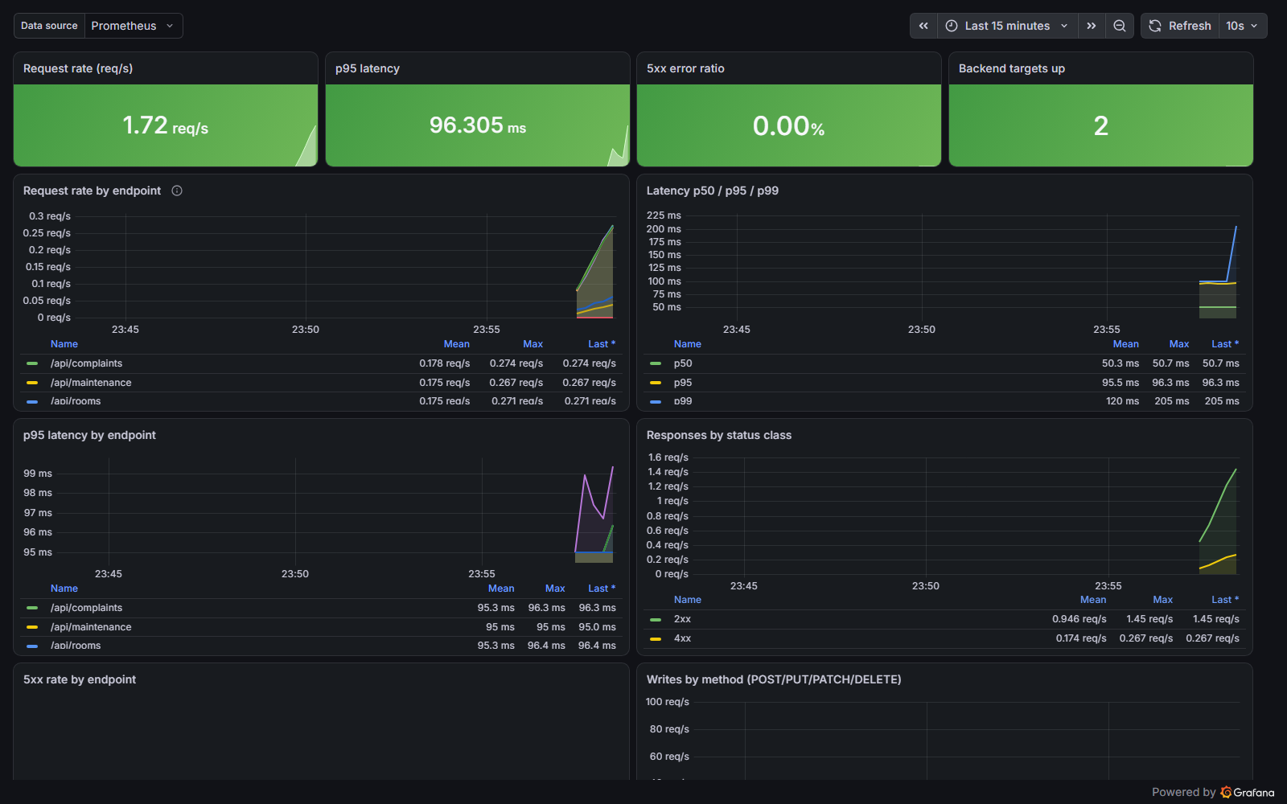
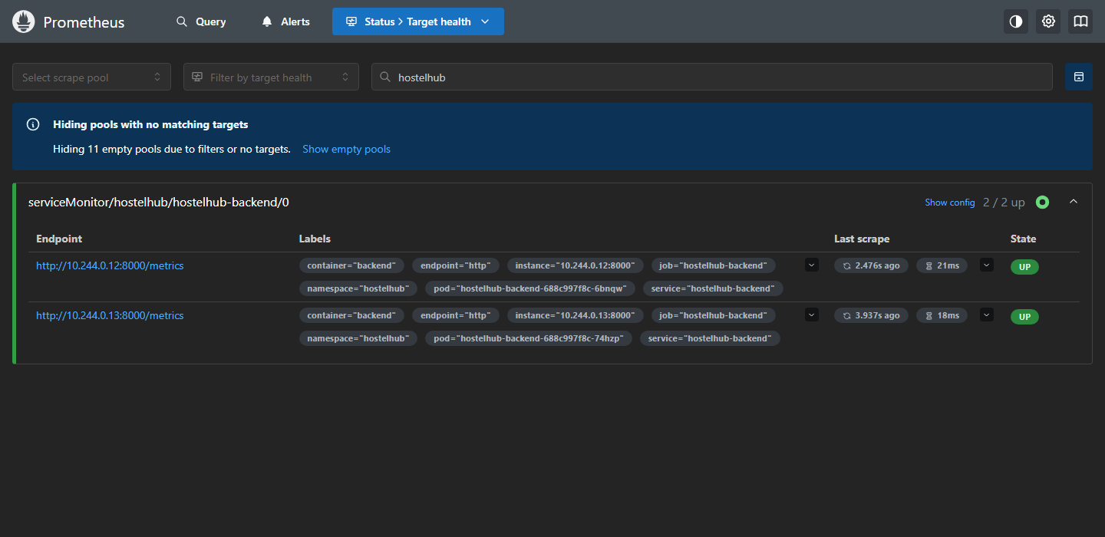
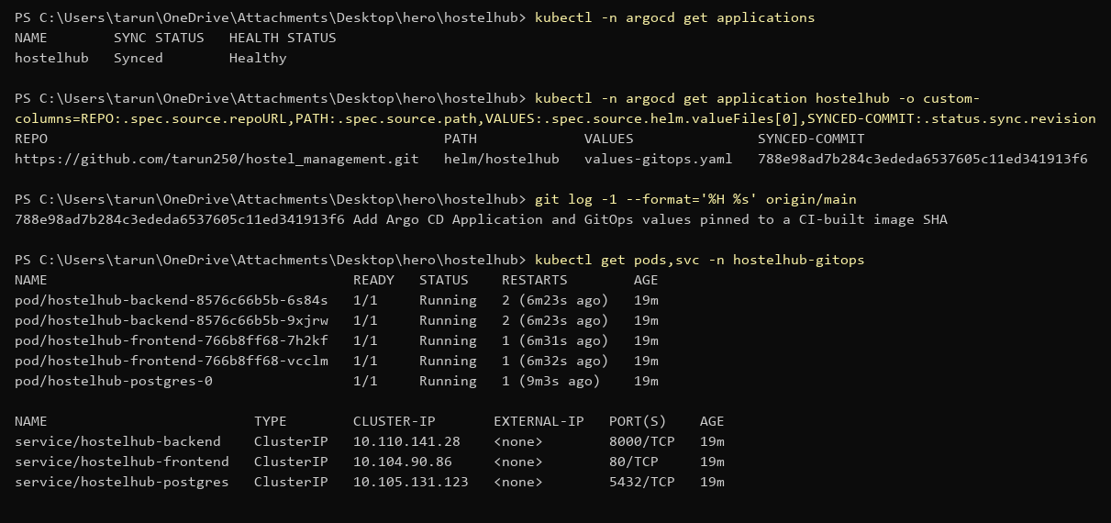
13 / OPERATE AND RECONCILE
Monitoring and GitOps
Prometheus
Grafana
Argo CD
Scrapes backend metrics at /metrics.
Visualizes request rate, latency and error signals.
Watches Helm config and syncs desired state.
Monitoring and GitOps are separate concerns: one shows system health; the other reconciles deployment configuration.
15

Slide 17
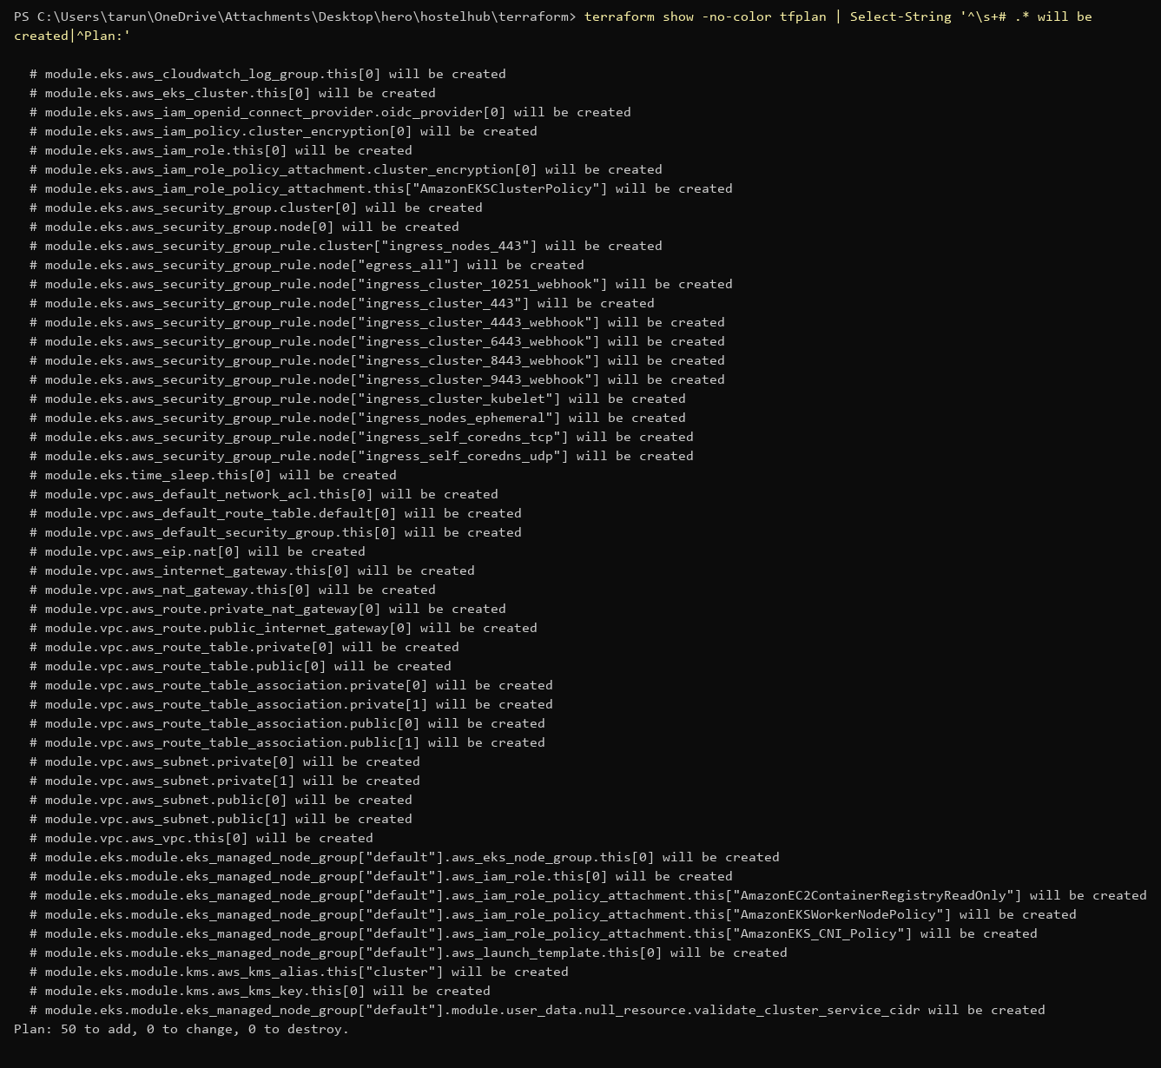
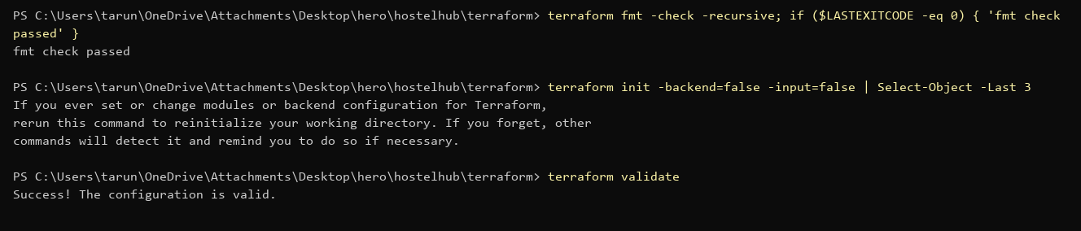
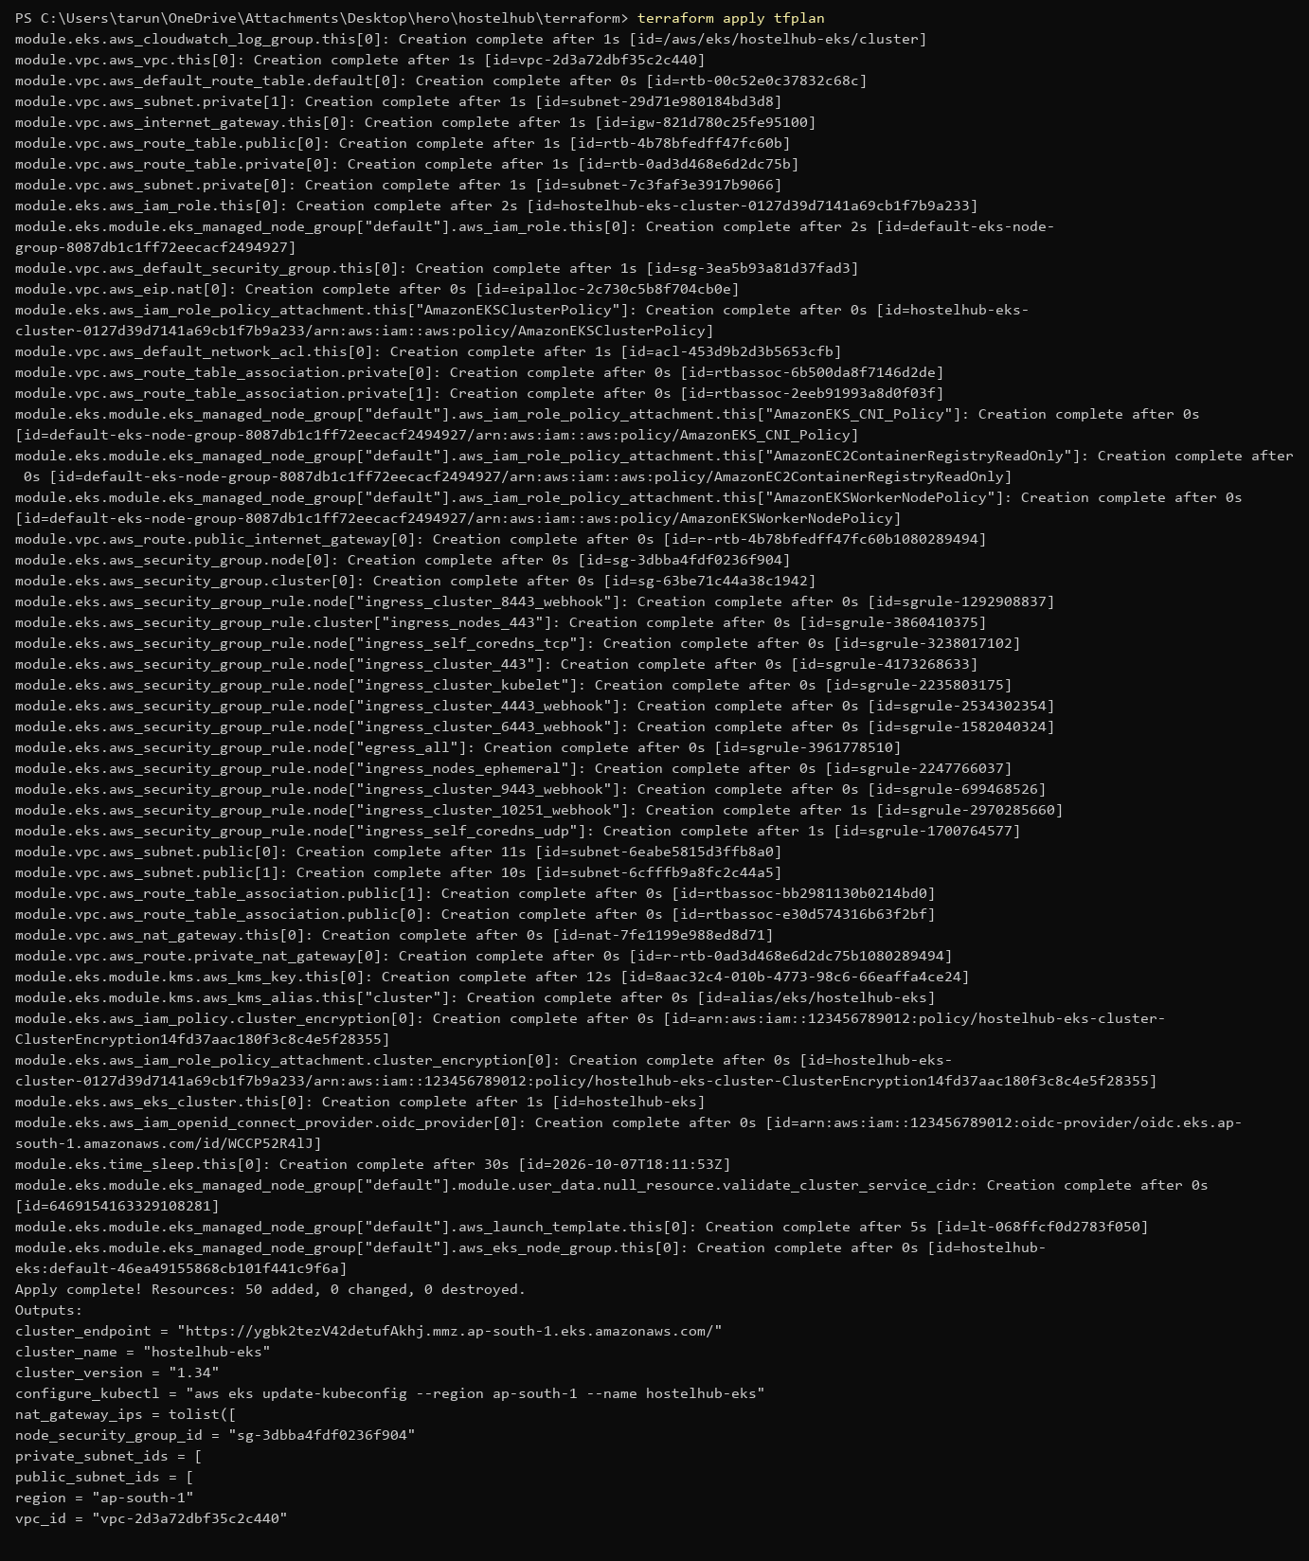
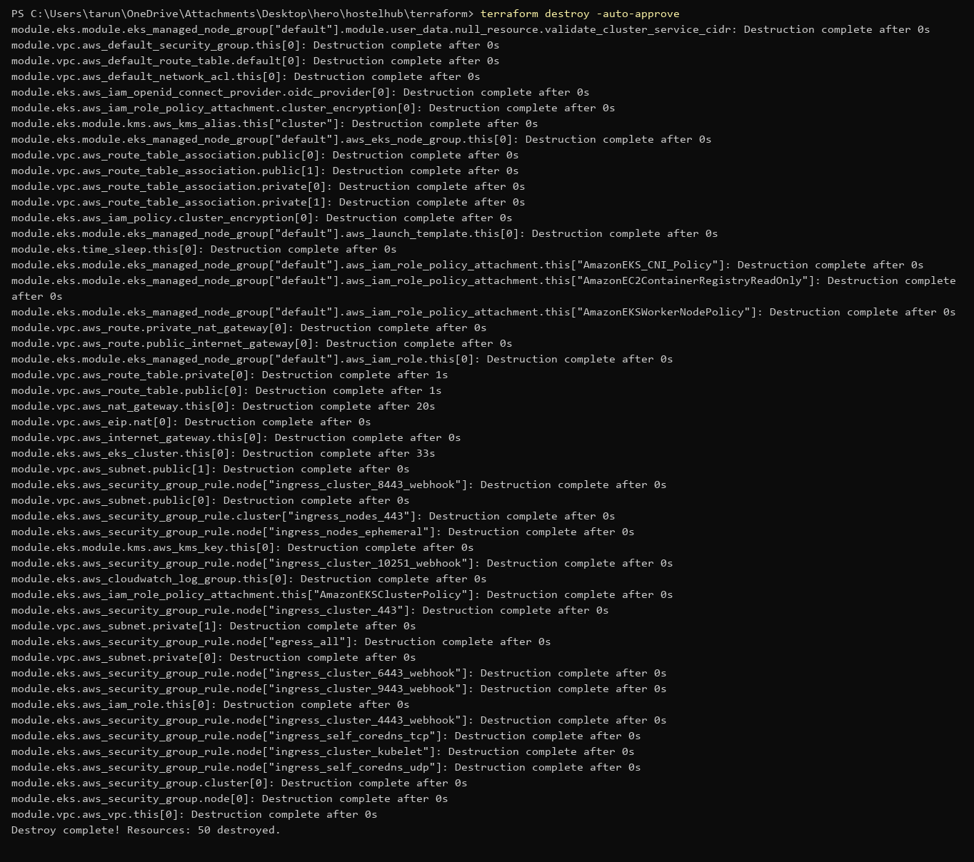
14 / CLOUD INFRASTRUCTURE
Infrastructure as code: Terraform
Important scope note: README states Terraform was exercised against Moto mock services; this is not proof of a live AWS EKS deployment.
16

Slide 18
15 / SUMMARY
What was demonstrated
Delivered
Honest boundary
• Working UI + REST API, 22 tests
• CI: test → build → Trivy → GHCR
• Helm on Kubernetes, Argo CD GitOps
• Prometheus + Grafana, Terraform VPC + EKS
• Kubernetes runs on minikube and kind
• Terraform tested against mock AWS (Moto)
• No real AWS account was used
github.com/tarun250/hostel_management
17

Slide 19
Thank you
HostelHub — a full-stack application with an automated DevOps delivery path.
github.com/tarun250/hostel_management

